Slide 1
Rounders (1998)
ANLY 515-50-2017: Course Project
Nelson Corrocher
Serge Savchuk

Slide 2
Plot
Mike, a poker player and law student, dreams about the World Series of Poker (WSOP).
In one game with Teddy KGB, another pro, Mike goes all-in and loses all his money.
Mike works hard to return to pro poker and rebuild bankroll, still dreaming of WSOP
In an epic all-night game, he beats Teddy and more than recover his bankroll.
Mike drops out of law school, breaks with girlfriend and is moving to Las Vegas to pursue his dream.

Slide 3
Analysis Focus (Questions)
We build our model to answer two questions:
In the beginning, was it correct for Mike to go all-in against Teddy KGB after the ”River” (last card) was flopped?
What would have been the best move for Mike to do instead?

Slide 4
Analysis Basis
Probability calculations are based on:
Book “No Limit Hold ’em: Theory and Practice” D. Sklansky, E. Miller (2006)
Poker hand simulators and underlying game rules
Nelson’s experience as a poker player
Assumptions:
Players are rational and trying to maximize their profit
Players don’t make silly mistakes
No cheating involved

Slide 5
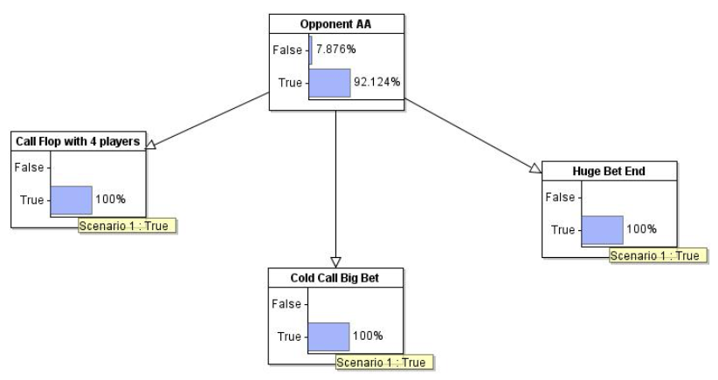
Model

Slide 6
Analysis Outcome (Answers)
Model provided us with the following answers:
Mike’s decision to call Teddy after the ”River” was not good, given his 17.6% chance of winning vs 42.8% required to break-even; going all-in and raising bet x2.4 made odds much worse to the 17.6% available vs 70.5% required.
Mike should not have gone all-in, as odds where clearly against him, but instead should have folded or at least called without raising. Also, he should not have bet all his capital, which led him into bankruptcy.

